Slide 1
Enhancing Person-Job Fit for Talent Recruitment : An Ability-aware Neural Network Approach
Advisor: Jia-Ling Koh
Presenter: You-Xiang Chen
Source: sigir ‘18
Data: 2019/01/15

Slide 2
Outline
Introduction
Method
Experiment
Conclusion

Slide 3
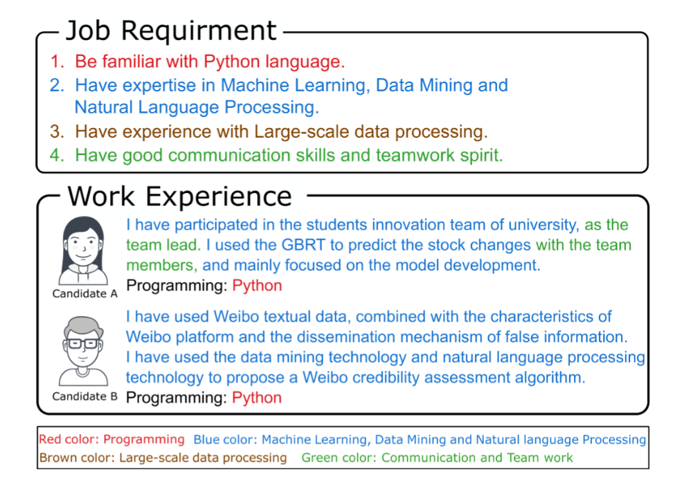
Motivation
Person-Job Fit largely depend on the manual inspection of features or key phrases from domain experts , and thus lead to high cost and the in efficient , inaccurate , and subjective judgments.

Slide 4
Goal
Reducing the dependence on manual labour and can provide better interpretation about the fitting results.
Notes:
Interpretation 解釋性

Slide 5
Outline
Introduction
Method
Experiment
Conclusion

Slide 6
Problem Formulation
Matching degree between job requirements in a posting and the experiences in a resume.
$J=\left\{j_{1},j_{2},…,j_{p}\right\}$
$j_{l}=\{j_{l,1},j_{l,2},…,j_{l,m_{l}}\}$
$R=\left\{r_{1},r_{2},…,r_{q}\right\}$
$r_{l}=\{r_{l,1},r_{l,2},…,r_{l,n_{l}}\}$

Slide 7
Problem Formulation
Matching degree between job requirements in a posting and the experiences in a resume.
A recruitment result $y∈\{0,1\}$ whether the candidate has passed the interview process.
Notes:
這篇要處理的是 Job fit 的問題，
所以這邊用 J 來表示 ability requirements，
用 R 來表示

Slide 8
Framework

Slide 9
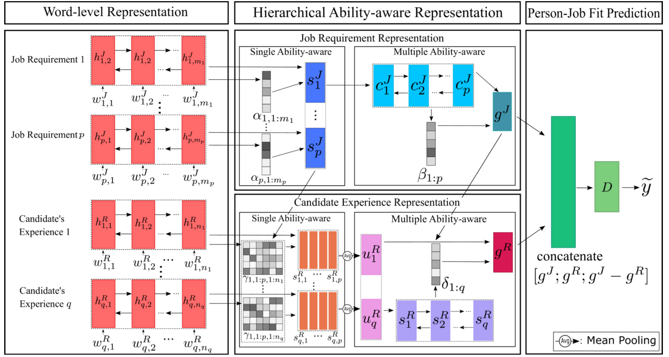
Word-level Representation
Bi LSTM
$\overset{⃑}{h_{t}}=LSTM\left(x_{t},\overset{⃑}{h_{t−1}}\right)$
$\overset{⃐}{h_{t}}=LSTM(x_{t}, \overset{⃐}{h_{t+1}})$
$h_{t}^{′}=[\overset{⃑}{h_{t}};\overset{⃐}{h_{t}}]$
Modeling word-level representation in job posting J and resume R.
Notes:
為了將 word 之間的順序依賴性嵌入到相應的表示中，用RNN->BI-LSTM
WJ l,t 代表第 l 個 Job-Requirement 的第 t 個字
其中 We 代表已經 Pre-train 過的 Embedding

Slide 10
Hierarchical Ability-Aware Representation
Notes:
作者認為每項能力要求都是指工作的特定需求，工作的全部需求可以從其所有要求中進一步總結
因而設計此層
1)Single Ability-aware in Job Requirement for getting the semantic representation of each requirement in a job posting;
2)Multiple Ability-aware in Job Requirement for further extracting entire representation of a job posting,
3)Single Ability-aware in Candidate Experience for highlighting some experiences in resumes by ability requirements;
4)Multiple Ability-aware in Candidate Experience for finally profiling candidates with all previous experiences.

Slide 11
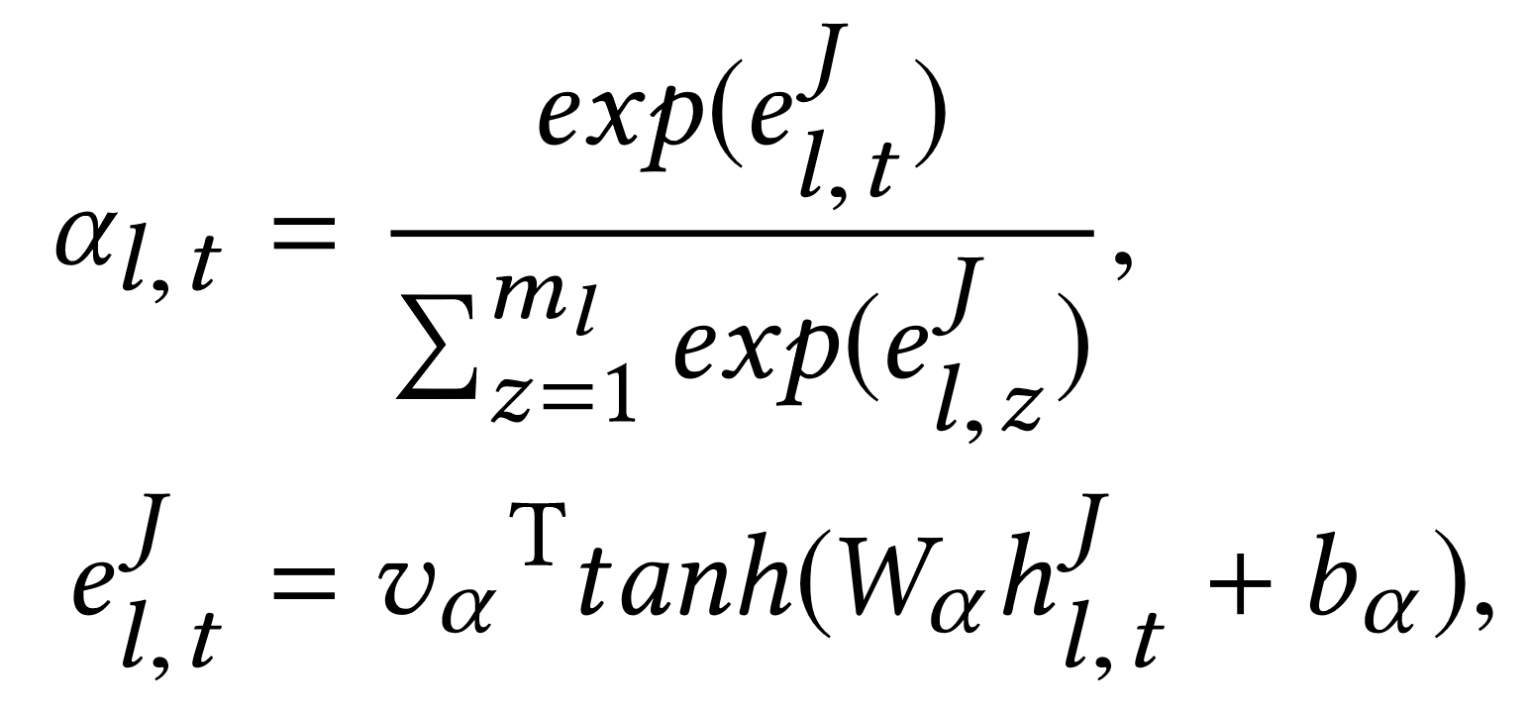
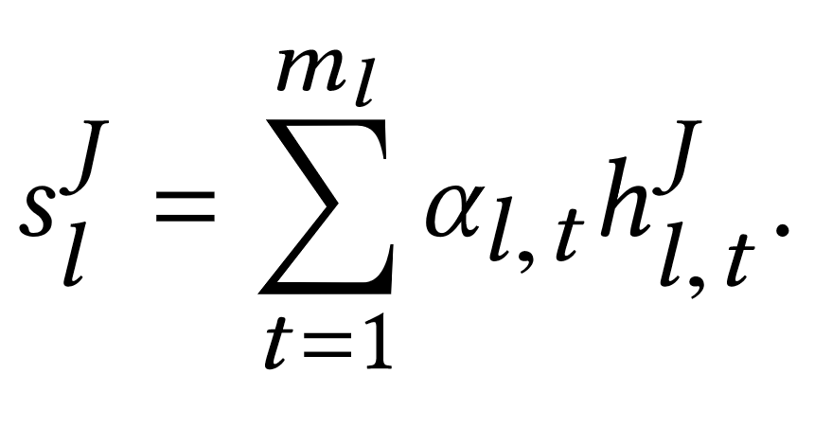
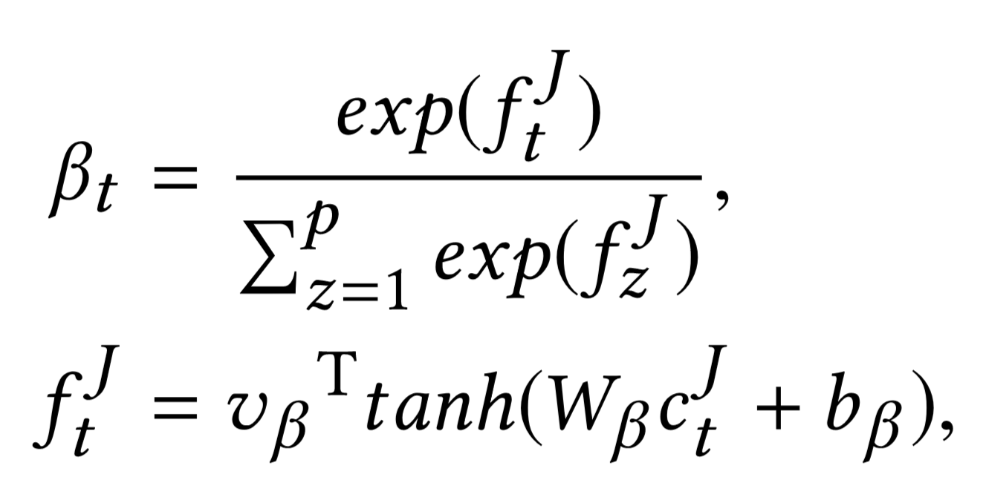
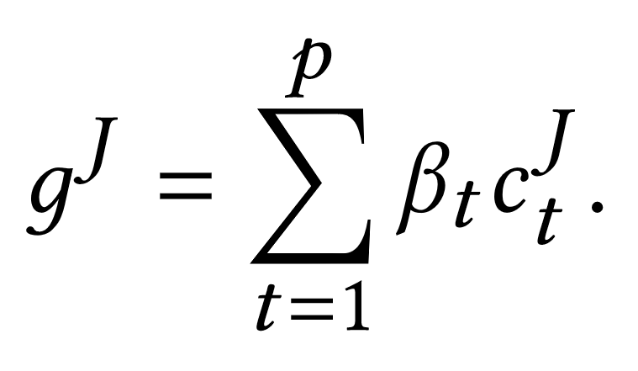
Hierarchical Ability-Aware Representation
Single Ability-aware in Job Requirement
Multiple Ability-aware in Job Requirement
Notes:
t = 1~ml

Slide 12
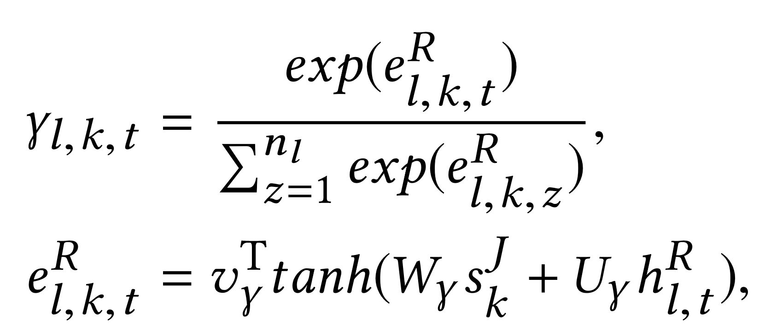
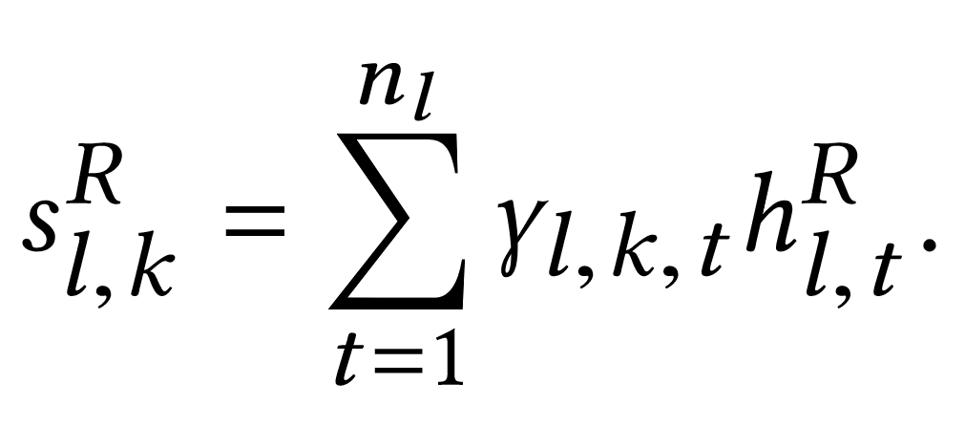
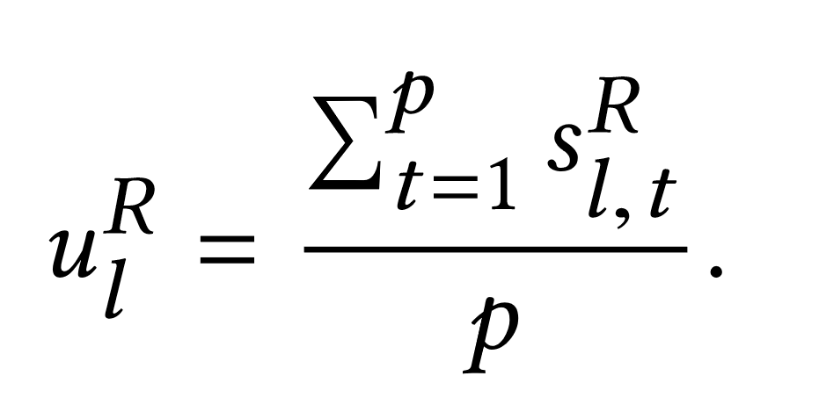
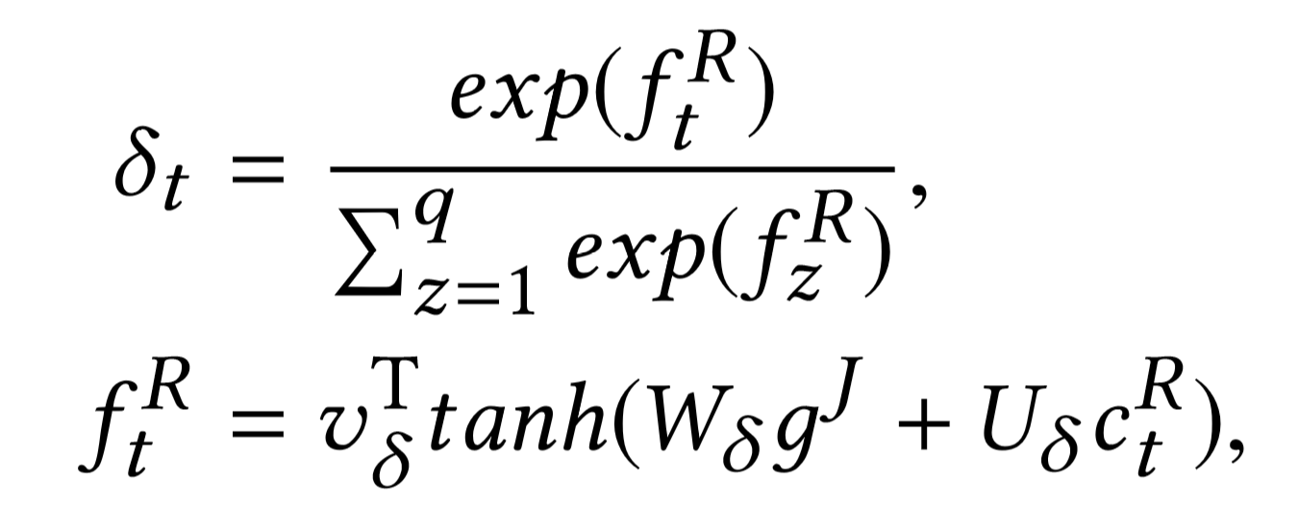
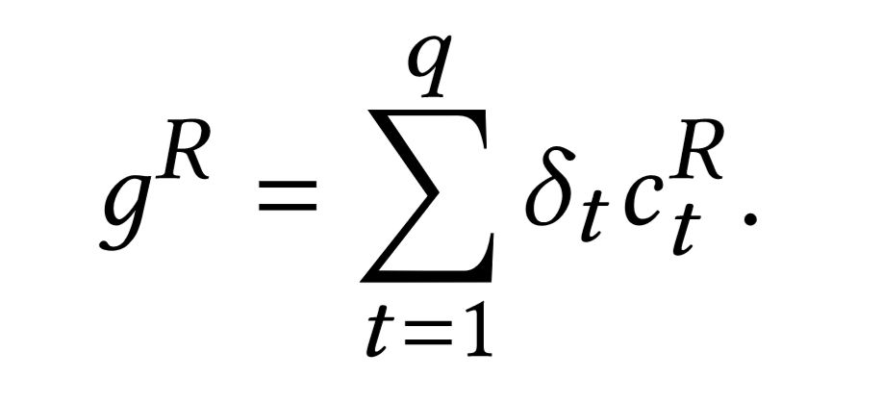
Hierarchical Ability-Aware Representation
Single Ability-aware in Experience
Multiple Ability-aware in Experience
(Avg pooling)

Slide 13
Person-Job Fit Prediction
Jointly learning the representations for both job postings and resumes
Notes:
Fully-connected network

Slide 14
Outline
Introduction
Method
Experiment
Conclusion

Slide 15
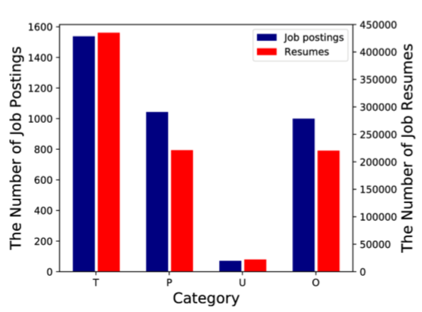
Dataset
17,766 job postings
898,914 resumes

Slide 16
Experiment setup
Word Embedding
Using Skip-gram model to pre-train the word embedding.

Slide 17
Performance

Slide 18
Performance

Slide 19
Computational Efficiency

Slide 20
Outline
Introduction
Method
Experiment
Conclusion

